Slide 1




Servlet/JSP DB Connection

Slide 2
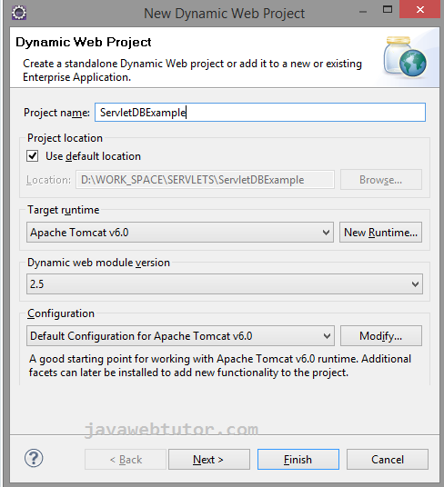

DB

Slide 3
register.html
<form action="register" method="post">
Name:<input type="text" name="userName"/><br/> Password:<input type="password" name="password"/><br/> Email Id:<input type="text" name="email" /><br/> Language: <select name="language">
<option>Hindi</option> <option>English</option> <option>French</option>
</select> <br/>
<input type="submit" value="Submit"/> </form></body></html>

Slide 4
RegisterServlet.java
package com.jwt.servlet;
import java.io.IOException; import java.io.PrintWriter; import java.sql.Connection;
import java.sql.DriverManager;
import java.sql.PreparedStatement; import javax.servlet.ServletException; import javax.servlet.http.HttpServlet;
import javax.servlet.http.HttpServletRequest; import javax.servlet.http.HttpServletResponse;
public class RegisterServlet extends HttpServlet {
public void doPost(HttpServletRequest request, HttpServletResponse response)
throws ServletException, IOException {
response.setContentType("text/html"); PrintWriter out = response.getWriter();
4

Slide 5
String n = request.getParameter("userName"); String p = request.getParameter("password"); String e = request.getParameter("email"); String c = request.getParameter("language"); try {
Class.forName("com.mysql.jdbc.Driver"); Connection con = DriverManager.getConnection(
RegisterServlet.java
"jdbc:mysql://localhost:3306/servlet", "root", "mukesh");
PreparedStatement ps = con
.prepareStatement("insert into USERDETAILS values(?,?,?,?)");
ps.setString(1, n); ps.setString(2, p); ps.setString(3, e); ps.setString(4, c);

Slide 6
int i = ps.executeUpdate(); // returns the binary value 0/1
if (i > 0)
RegisterServlet.java
out.print("You are successfully registered...");
} catch (Exception e2) {
System.out.println(e2);
}
out.close();
}
}

Slide 7
<servlet>
<servlet-name>Register</servlet-name>
WEB.xml
<servlet-class>com.jwt.servlet.RegisterServlet</servlet-class>
</servlet>
<servlet-mapping>
<servlet-name>Register</servlet-name>
<url-pattern>/register</url-pattern>
</servlet-mapping>
<welcome-file-list>
<welcome-file>register.jsp</welcome-file>
</welcome-file-list>

Slide 8
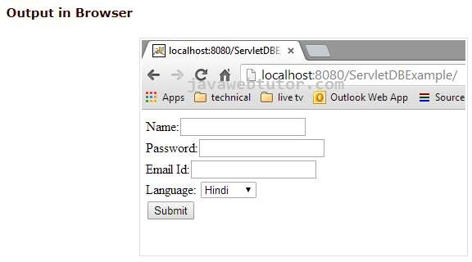
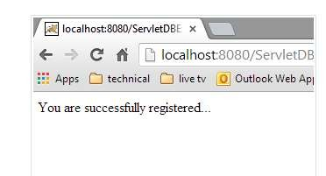
output

Slide 9
Login.jsp
<%@page import="java.sql.ResultSet"%>
<%@page import="java.sql.Statement"%>
<%@page import="java.sql.Connection"%>
<%@page import="com.example.util.DBUtil"%>
<%
String userName = request.getParameter("username"); String password = request.getParameter("password"); Connection con = DBUtil.getMySqlConnection(); Statement st = con.createStatement();
ResultSet rs;
rs = st.executeQuery("select * from EMPLOYEE where USER_NAME='"
+ userName + "' and PASSWORD='" + password + "'");
if (rs.next()) { session.setAttribute("username", userName); response.sendRedirect("success.jsp");
}
else
{
out.println("Invalid password <a href='index.jsp'>try again</a>");
} %>
9

Slide 10
<%@page import="java.sql.Statement"%>
<%@page import="java.sql.Connection"%>
registration.jsp
<%@page import="com.example.util.DBUtil"%>
<%
String userName = request.getParameter("username"); String password = request.getParameter("password"); String firstName = request.getParameter("firstname"); String lastName = request.getParameter("lastname"); String email = request.getParameter("email"); Connection con = DBUtil.getMySqlConnection(); Statement st = con.createStatement();
int i = st.executeUpdate
10

Slide 11
("insert into EMPLOYEE
(FIRST_NAME, LAST_NAME, EMAIL, USER_NAME, PASSWORD)
Login.jsp
values (‘”+ firstName+ "',‘”+ lastName+ "',‘”+ email+ "',‘”+ userName+ "',‘”+ password+ "')");
if (i > 0) { response.sendRedirect("welcome.jsp");
} else {
response.sendRedirect("index.jsp");
}
%>
11

Slide 12
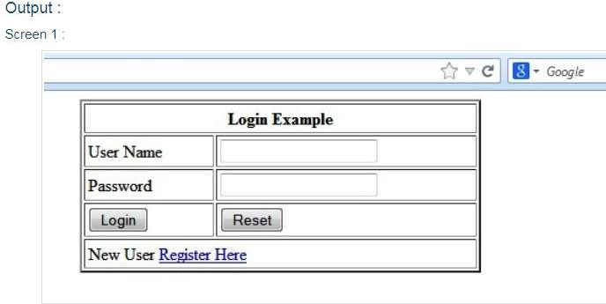
Login.jsp
12

Slide 13
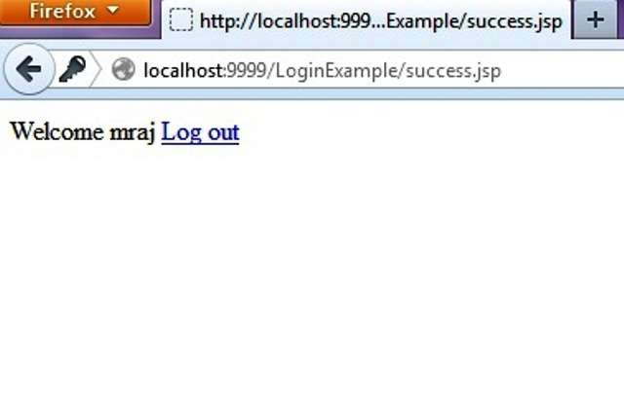
success.jsp
13

